Slide 1
The Battle of Neighborhoods

Slide 2
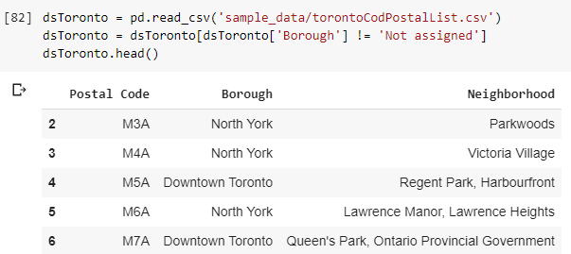
Collecting data

Slide 3
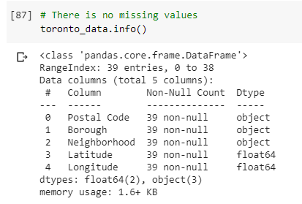
Detecting missing values

Slide 4
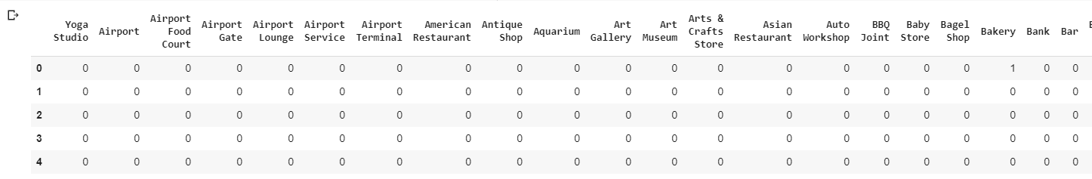
Categorizing data

Slide 5
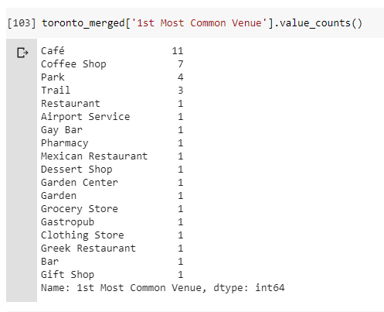
Getting common values

